Slide 1
Bail Bond Project: Phase 2
Hannah Laper
Venkatesh Rudrappa
Tara Bhardvaj

Slide 2
What is Bond?
Bail refers to the fee or condition by which someone who has been arrested is allowed to leave jail as they await a trial or hearing. (ABA)
Arrest
Arraignment
Bail
Hearing
Hearing

Slide 3
Research questions
Can we predict whether bail will be set?
Can we predict the bail amount?
Can we predict the nonmonetary bail conditions?

Slide 4
Dataset
NYC Pretrial Release data
Source: NY Courts. Gov
https://ww2.nycourts.gov/pretrial-release-data-33136
Shape: (283034, 108) Raw Data
Date Range: 1/1/2018 – 6/30/2021
Fields: Race, Arrest id, Age at Crime, Gender, Bail made Indicator, Disposition, Internal_Case_ID

Slide 5
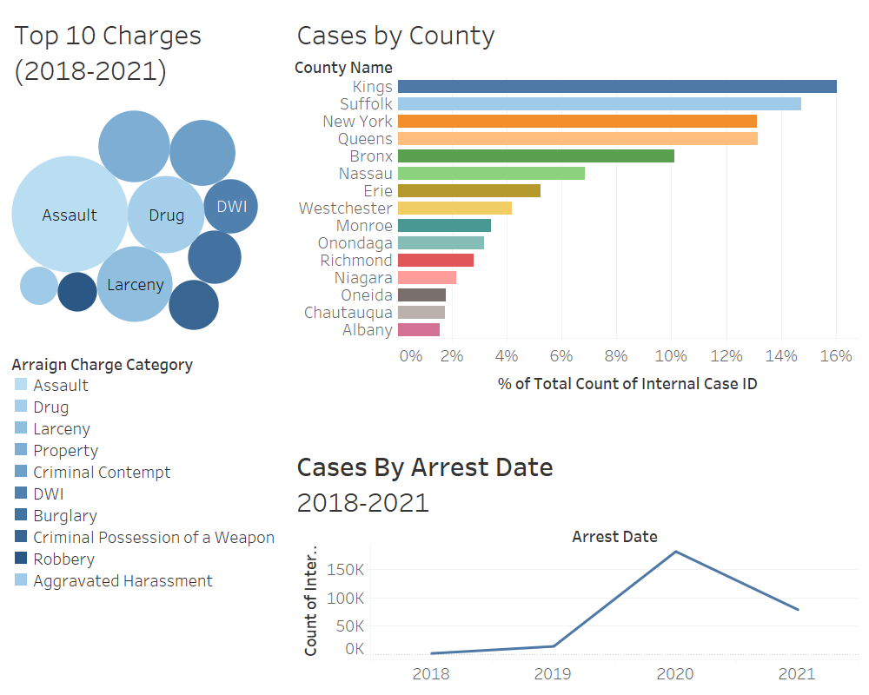

Slide 6
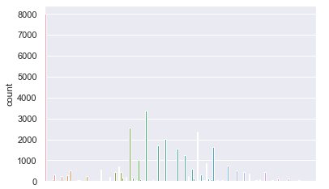
Bail Amount Distribution

Slide 7
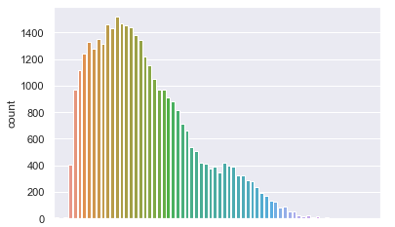
Age at Crime

Slide 8
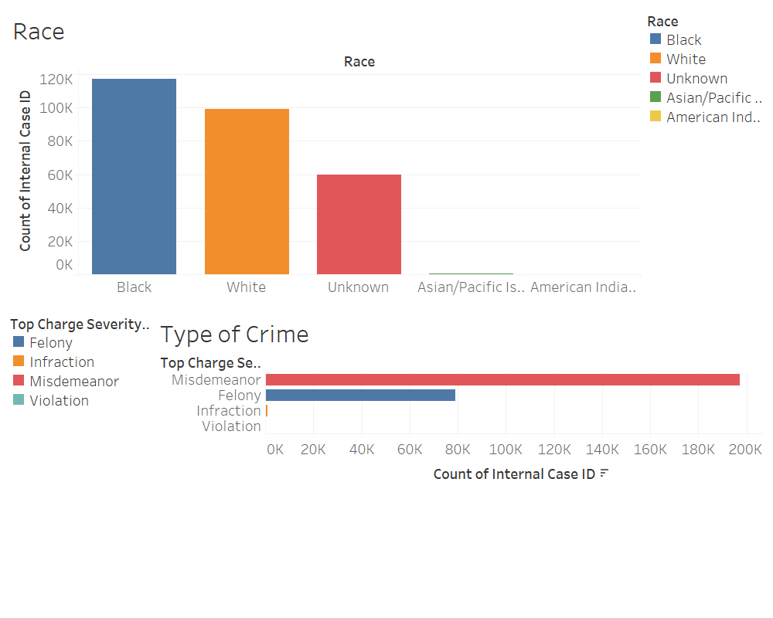
Demographics

Slide 9
Predicting if bail will be set
Features used : 'Gender', 'Age_at_Crime', 'Race', 'Ethnicity','Arraign Charge Category', 'Representation_Type', 'offense_timeperiod','Bail_status'
Model Used: Logistic Regression , Gaussian Naive Bayes
Challenges: Categorical values, NaN values
Evaluation: LeaveOneOutEncoder(), fillna(mode()), Data Normalization
Improvements: Tidy Data, Within specific range

Slide 10
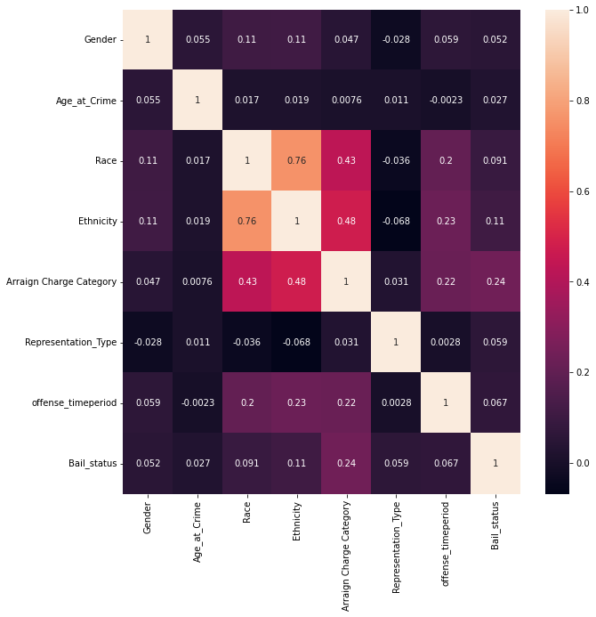
HeatMap to show correlation

Slide 11
Model Results
Logistic Regression
Binary Classification - probability of each element
Efficient to train data
Accuracy score: 71.6 %
F1 score: 0.83
Gaussian Naive Bayes
Predicts probabilities of each data record
Conditional independence
Accuracy score: 70.2%
F1 score: 0.81

Slide 12
Predicting Bail Amount
Linear Regression Model used, as continuous variable being predicted
Features used:'Gender', 'Bail_Amount', 'Violent_Fel’, “Race’, “Charge”, “Severity”, 'Bail_Pct'
Challenges: distribution of Bail amounts led to low model performance
Evaluation:
mse is : 0.044362494578216304
r2 is : 0.4641088149363073

Slide 13
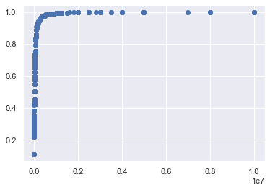
Bail Amount vs. Bail Percentile

Slide 14
Predicting Nonmonetary Bail Conditions
Non-Monetary Bail Restrictions can be anything from house arrest to maintaining employment.
Model(s) Used: Logistic Regression, Naives Bayes, KNN, MultiOutput Classifier, MultiOutput Classifier
Features used: Gender, Race, Age at Crime, Region, Judge Name, Arrest Charge Categories, and Representation Type
Challenges: Categorical Outputs, Predicting Multiple Variable Outputs,
Evaluation: Cleaning Data, Using Leave One Out Encoder
Improvements: Feature Scaling, Refining features, Optimizing Parameters

Slide 15
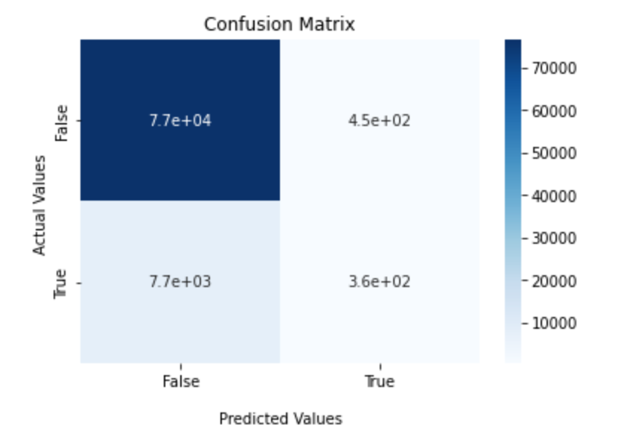
Logistic Regression
Outcome
Accuracy: 90%
Runtime: Very quick
To Improve: Use GridSearch to optimize parameters
Confusion Matrix

Slide 16
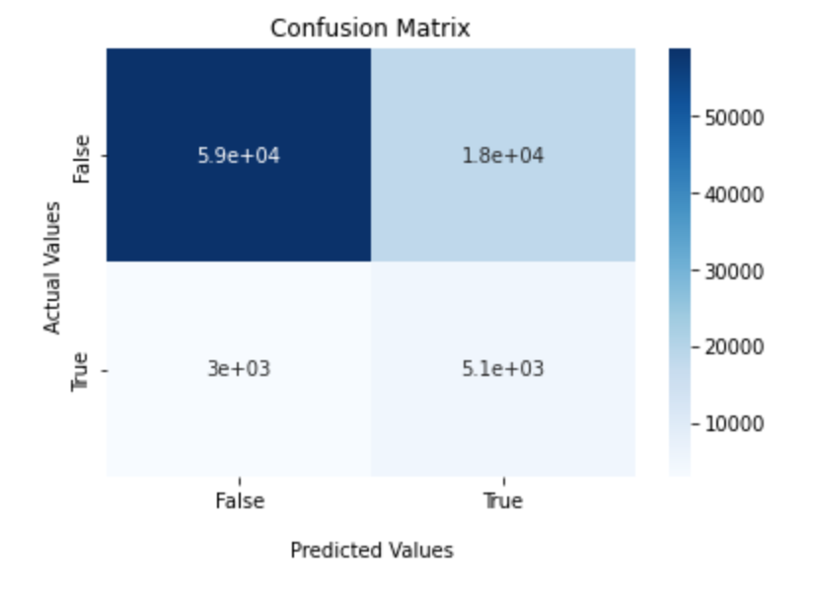
Naive Bayes
Outcome
Accuracy: 75%
Runtime: Moderate
To Improve: Use GridSearch to optimize parameters
Confusion Matrix

Slide 17
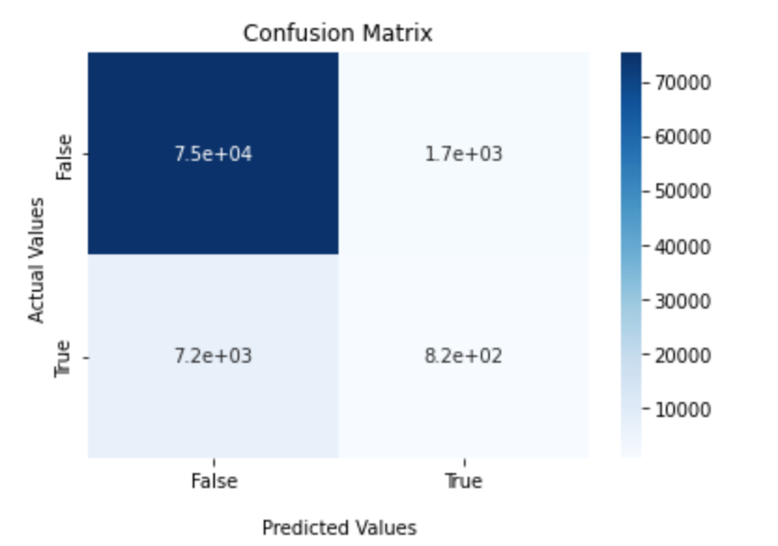
KNN
Outcome
Accuracy: 89.5%
Runtime: Timely but Manageable
To Improve: Use GridSearch to optimize parameters
Confusion Matrix

Slide 18
MultiOutput Classification to Predict NMR(s)
About the Library
Library Created by sklearn
A wrapper used for multiple binary outputs (dependent variables)
MultiOutPut Classification with NMR data
Logistic Regression accuracy: 40%
Naive Bayes accuracy: 4%
To improve the model: optimize the parameters, try KNN and SVM.
For predicting different NMR, create a Chain Classifier Model

Slide 19
Next Steps
1. Refining Models (trying different models)
2. Hyperparameter tuning
3. Trying different input features
4. Visualizing differences between groups

Slide 20

Questions, Comments, Concerns

